Slide 1
Chapter 5 – Extracellular Matrix as a Bioscaffold for Tissue Engineering

Slide 2
Notes:
Figure 5.1: Schematic representation of the assembly of collagen I.

Slide 3
Notes:
Figure 5.2: Fibronectin is a dimeric molecule joined by two disulfide bonds at the carboxyl end. Each domain of the fibronectin molecule has binding sites for cell receptors and ECM molecules.

Slide 4
Notes:
Figure 5.3: Laminin is composed of three polypeptide chains (α, β1, and β2) organized into the shape of a cross. Laminin has binding domains for heparin, collagen IV, heparin sulfate, and cells.

Slide 5
Notes:
Figure 5.4: Glycosaminoglycans are long unbranched polysaccharides that are composed of a repeating disaccharide unit. The disaccharide unit is composed of one of two modified sugars, either N-acetylgalactosamine or N-acetylglucosamine.

Slide 6
Notes:
Figure 5.5: Peptides of urinary bladder matrix (UBM) were fractionated via ammonium sulfate precipitation and subsequent size exclusion, ion exchange, and reverse phase chromatography.

Slide 7
Notes:
Figure 5.6: The urinary bladder matrix as an effectively decellularized biologic scaffold.
Adapted from An overview of tissue and whole organ decellularization processes, Crapo et al., 2011, Biomaterials 32 3233–3243.

Slide 8
Notes:
Figure 5.7: The remodeling outcome associated with biologic scaffolds depends upon a variety of factors including the effectiveness of the scaffold decellularization process (Keane et al., 2012), and whether or not the scaffold material has been chemically cross-linked (Valentin et al., 2006), among others.

Slide 9
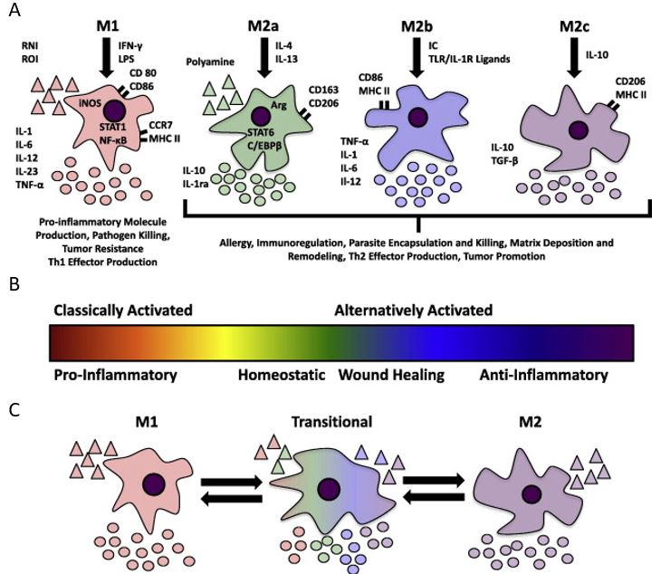
Notes:
Figure 5.8: Macrophages have typically been recognized as phagocytic and antigen presenting cells responsible for propagating the proinflammatory response of the mammalian innate immune system.
From Expanded applications, shifting paradigms and an improved understanding of host-biomaterial interactions, Brown and Badylak, 2013, Acta Biomater. 9 4948–4955.

Slide 10
Notes:
Figure 5.9 A marine suffering from VML of the quadriceps femoris muscle.
Adapted from Clinical application of an acellular biologic scaffold for surgical repair of a large, traumatic quadriceps femoris muscle defect, Mase et al., 2010 Orthopedics 33 511.

Slide 11
Notes:
Figure 5.10: Representative endoscopic images of ECM bioscaffold placement in a patient suffering from superficial esophageal adenocarcinoma.
From Esophageal preservation in five male patients after endoscopic inner-layer circumferential resection in the setting of superficial cancer: a regenerative medicine approach with a biologic scaffold, Badylak et al., 2011, Tissue Eng. Part A 17 1643–1650.

Slide 12
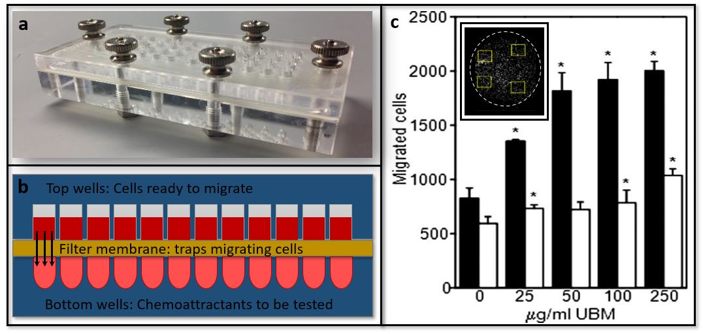
Notes:
Figure 5.11: a) The present study utilized a chemotaxis chamber. b) PVSCs were placed in the top wells while degradation products from UBM were placed in the bottom wells. c) Migrated cells were trapped in an 8 μm pore membrane and stained with a nuclear stain for counting and subsequent quantification. d) The present study showed that degradation products from UBM promoted the chemotaxis of PVSCs in a dose-dependent manner (white bars), and that low oxygen conditions (black bars) potentiated this effect.
From Extracellular matrix degradation products and low-oxygen conditions enhance the regenerative potential of perivascular stem cells. Tottey et al., 2011, Tissue Eng. Part A 17 37–44.

Slide 13
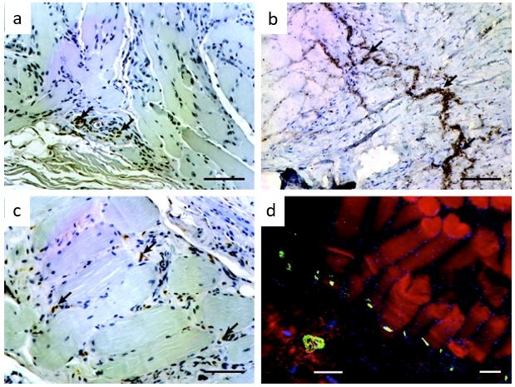
Notes:
Figure 5.12: Innervation of remodeled small intestinal submucosa-ECM implants. Sections (figures 5.12 a to c) were immunolabeled for β-tubulin 3 to identify neurons (brown) within the remodeled tissue. In the fluorescent image (figure 5.12 d), α-bungarotoxin (green) showed many motor end plates within regenerated skeletal muscle tissue (red).
From Xenogeneic extracellular matrix as an inductive scaffold for regeneration of a functioning musculotendinous junction, Turner et al., 2010, Tissue Eng. Part A 16 3309–3317.

